Slide 1
IoT Workshop (Week 1)
Peyton Casper
peyton.casper@studentpartner.com

Slide 2
Overview
What is a Microcontroller?
Arduino Uno vs Spark Core
Create the Blink Circuit
Write the Blink Program

Slide 3
Microcontroller
Small and low-cost computer
Usually deals with one task
Low power usage
Contains a CPU, ROM, RAM and I/O

Slide 4
Arduino Uno
ATmega328P
16 MHz
32 KB Flash Memory
2 KB SRAM
14 Digital I/O Pins (6 are PWM)
6 Analog Pins

Slide 5
Spark Core
ARM Cortex M3’
72 MHz
128KB Flash Memory
20KB or RAM
8 Digital I/O Pins
4 PWM Pins
8 Analog I/O Pins
Wi-Fi

Slide 6
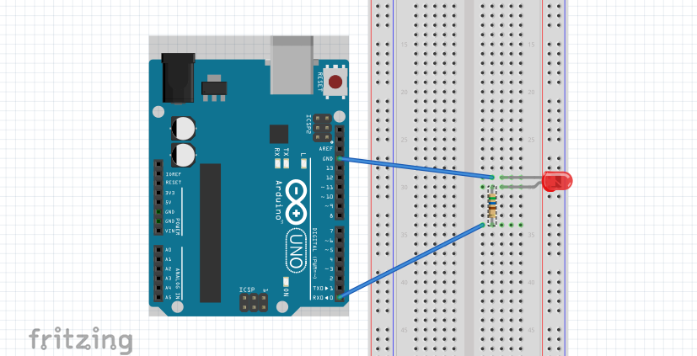
Blink Circuit

